Slide 1



Gameco.
Marketing project 2017
Galiazzo Nicora

Slide 2
Market analysis for 2017
Market share across regions
Global sales behavior
Video game genre analysis

Slide 3
Context and Data sample
This project is made to understand if there is any change in the markets or they stayed the same in order to adjust the marketing budget by regions
We will use a sample from 2006-2016, the reason behind this is because consoles before this period is not being produced therefore games neither.

Slide 4
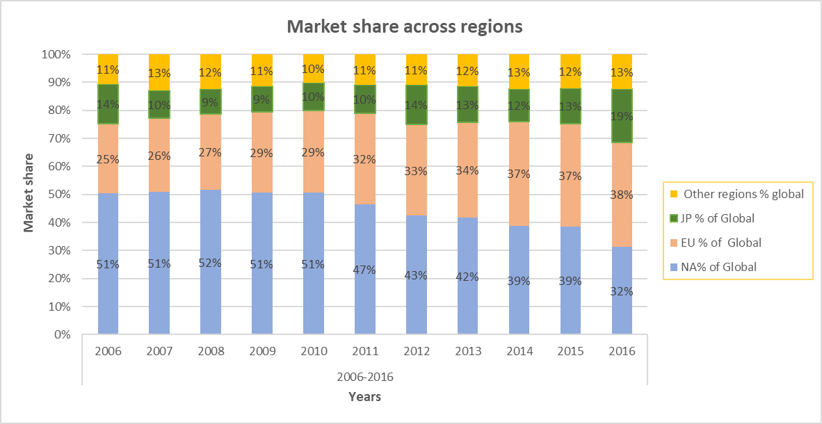
Market share by regions
Through this graph we can observe following facts:
A decline of the market share of NA region
This graphic show that the other markets absorb the demand in NA, being Eu the one one that show a bigger develop.
Japan show a slowly increase trough this years
Other region tends to move around 10-13% of market

Slide 5
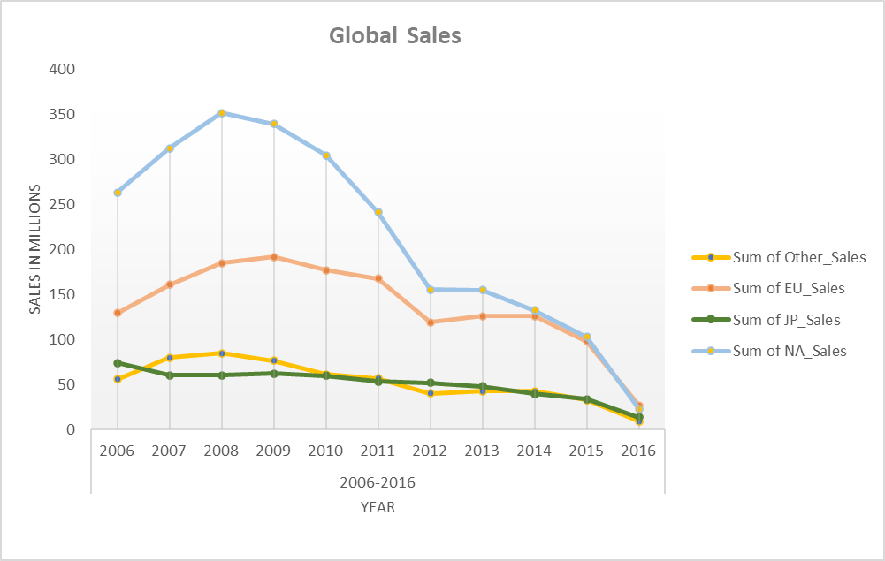
Sales gaming market
Since 2008 the market show a downtrend in the 3 biggest regions
NA , EU and JP show similar trend in terms of sales
This trend affect less other region
NA was quite big part of the market until 2012, in the figure we can observe this region is more volatile

Slide 6
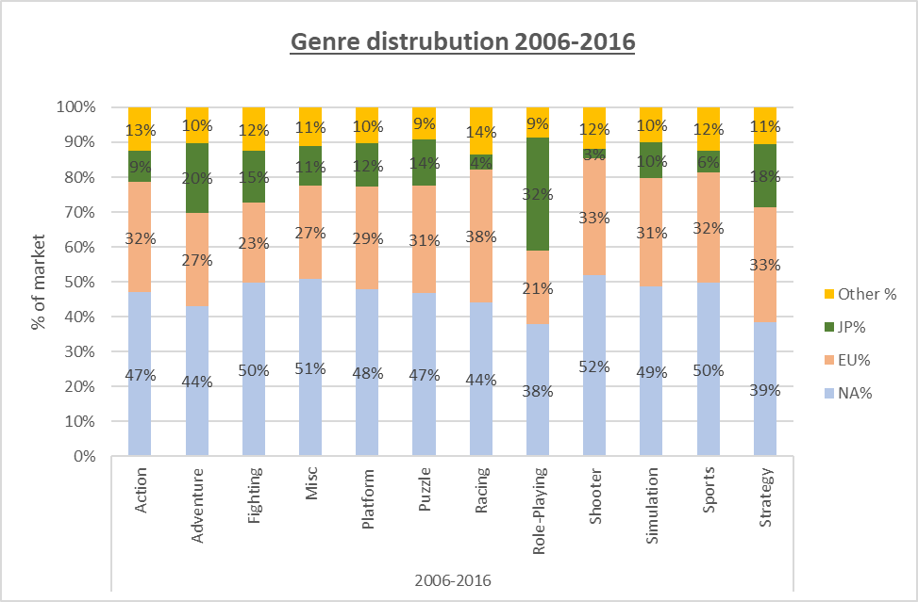
Genre distribution global 2006-2016
With this graph we can infer the consumptions habits by region
NA favorite genre is shooter, followed by Misc.
EU are the bigger consumer of racing games
JP have a big preference for Role-playing games
In Other regions raving game stand out

Slide 7
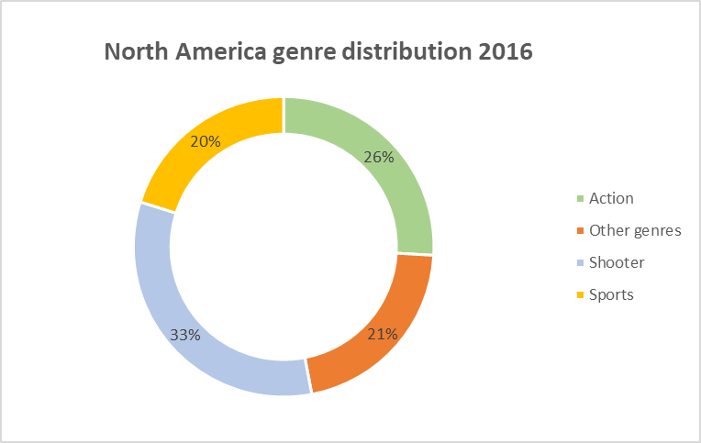
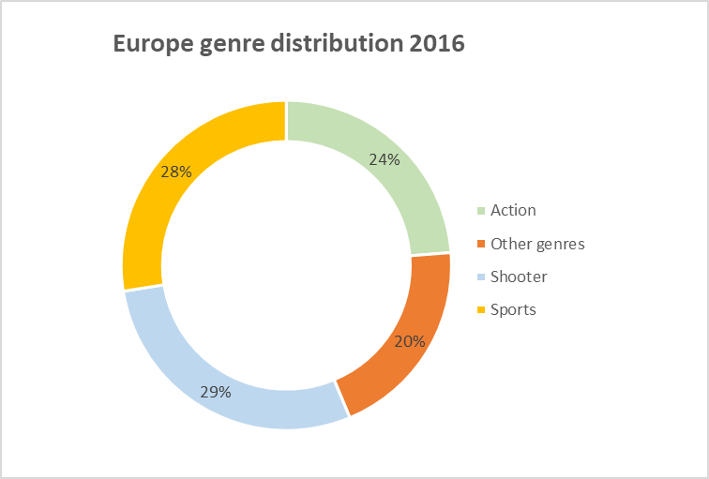
Genre analysis by region for 2016
North America
Shooter is the most preferred genre across NA, in consonance with the historic data.
Actions and sport genre around half market share
Europe
In Europe, there are 3 top preferences in 2016, with no genre clearly standing above the others.
We can conclude that preferences are broadly based
This graph confirms the trends of consumption habits in this region.

Slide 8
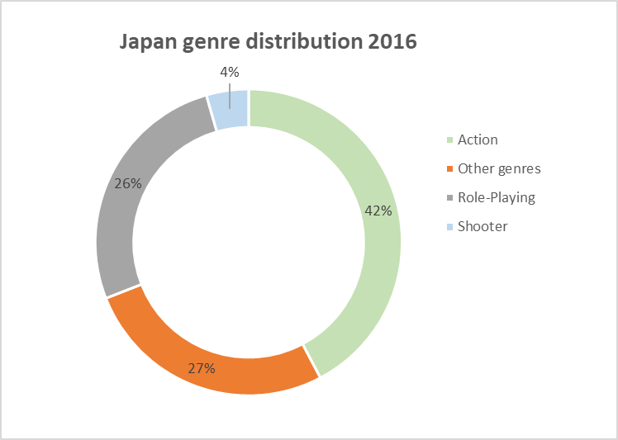
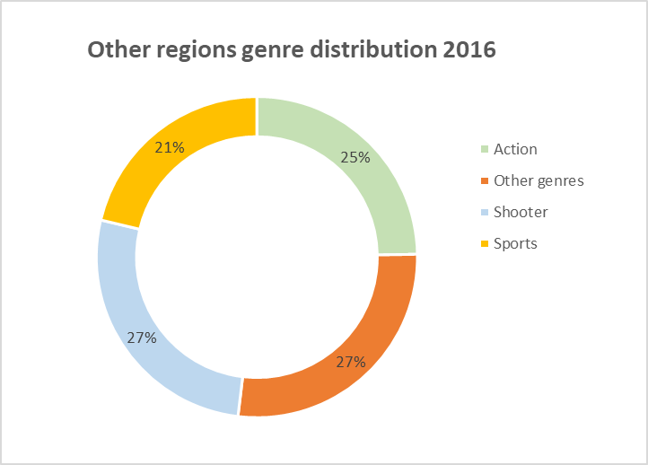
Genre analysis by region for 2016
Japan
Japan is a region that differs from other markets in terms of a specific genre.
The genre of the role-playing game stands out from all other regions.
Shooter is not demanded in this regions.
Other regions
In this region, due to the lack of data for the corresponding markets, we can see a similar pattern to the NA and EU markets.
Action, shooter and sport are the dominant genres.

Slide 9


Blank slide
Conclusions and recommendations
After the analysis we can conclude the market change in the last years, the clear dominance of NA dissolve and was absorbed by other markets, mostly by EU.
The marketing effort have to consider this changes and spend the budget in accordance of the insights.
For an maximum return in invest marketing team need to take in consideration the genres by regions, because the most demanded genres represent above 70% of each market.
Recommendation a further analysis should be done for 2008, since from that year market volume reduce a lot.

Slide 10
Thank for reading

